Slide 1
GENERATIVE AI
WEEK-2
Asst.Prof.Dr.Murat ŞİMŞEK

Slide 2
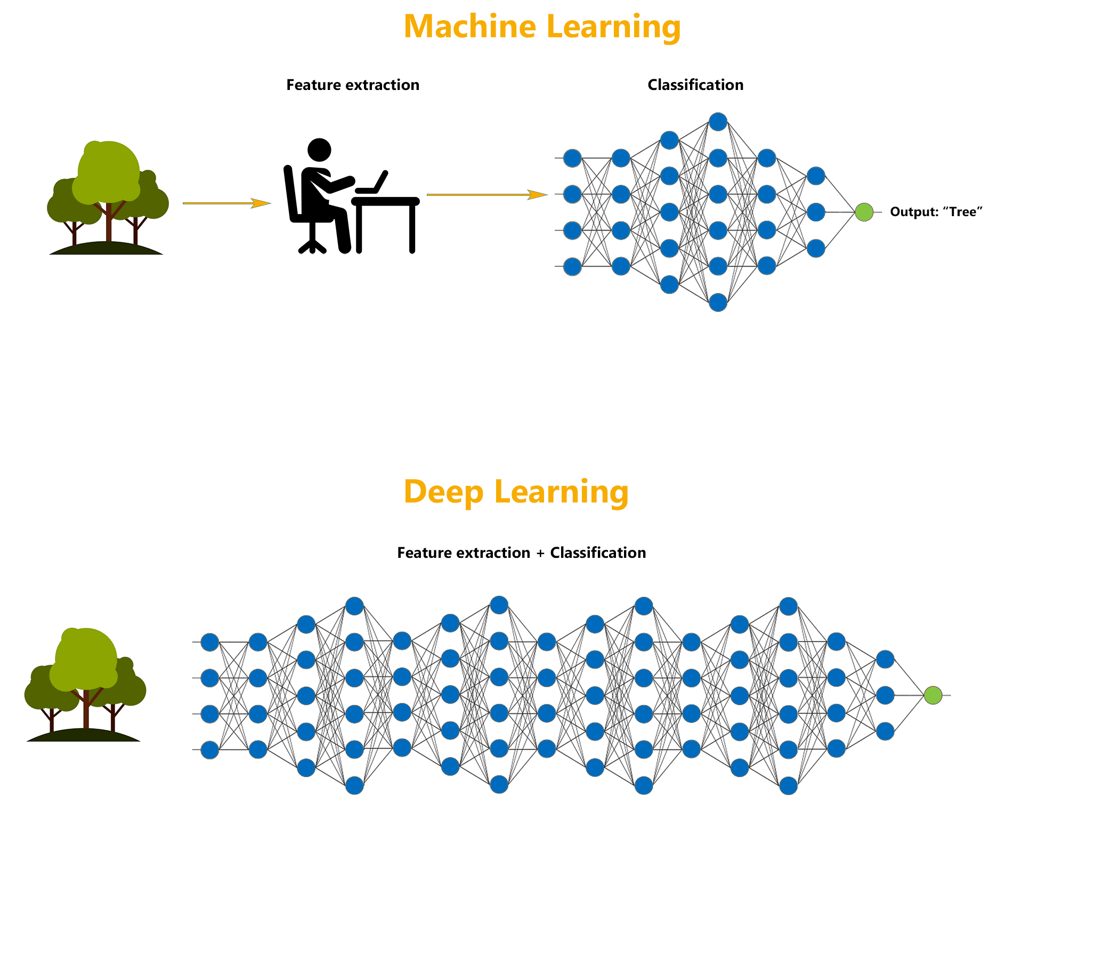
Deep Learning

Slide 3
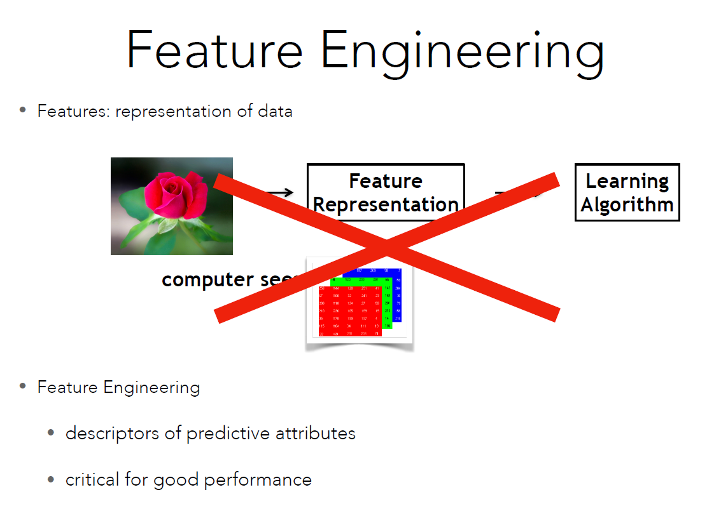
Deep Learning

Slide 4
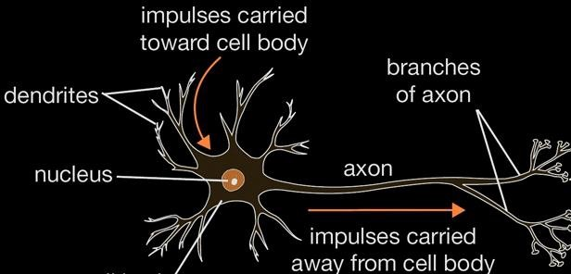
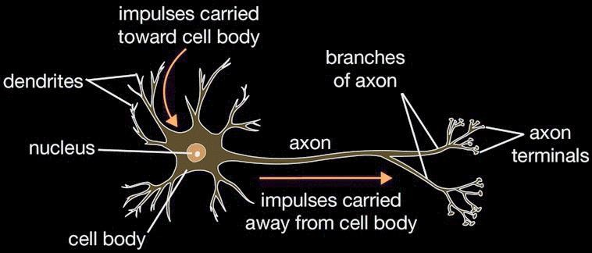


What is a Biological Neural Network (BNN)?
A Biological Neural Network is a network of neurons that are chemically connected or functionally related
A single neuron can be connected to many other neurons.
The total number of neurons and connections in a network can be extensive.i
synapse
3

Slide 5
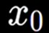
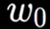















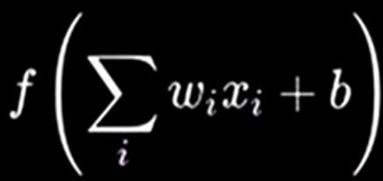
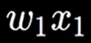
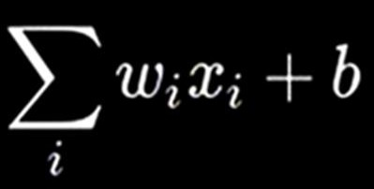

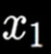
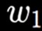









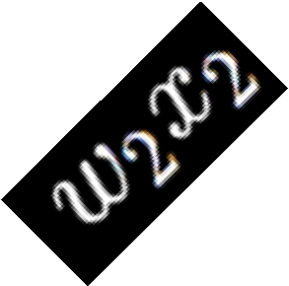


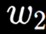

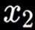

ARTIFICIAL NEURAL NETWORKS
Work on artificial neural networks has been motivated by the recognition that the human brain computes differently than a traditional digital computer
A neuron receives activation values ​​𝑥𝑖 from neurons connected to its dendrites.
The neuron must combine these activations.
synapse
synapse
Cell Body
Cell Body
f
f
axon from a
output axon
neuron
Activation
Activation
function
function
3

Slide 6
ARTIFICIAL NEURAL NETWORKS
The connections between neurons can be weak or strong.
The strength is represented by 𝑤𝑖 and the amount of information “received” by the neuron is the product of 𝑤𝑖𝑥𝑖.
The total contributions are added together with the bias 𝑏 to form the sum 𝑏 + σ𝑖 𝑤𝑖𝑥𝑖.
synapse
synapse
Cell Body
Cell Body
f
f
axon from a
output axon
neuron
Activation
Activation
function
function
3
Prepared by Prof. Dr. Hasan AMCA
6

Slide 7









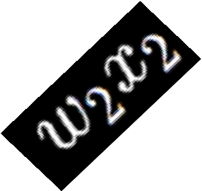

Artificial Neural Network Connections
synapse
synapse
synapse
Cell Body
Cell Body
f
f
axon from a
output axon
neuron
Activation
Activation
function
function
7

Slide 8































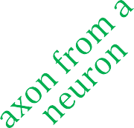









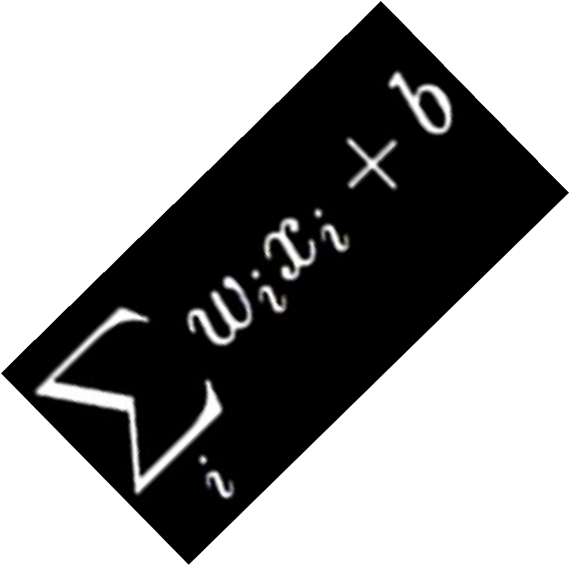
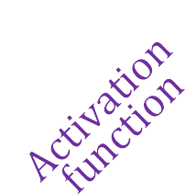

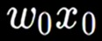




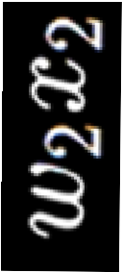
synapse
synapse
Artificial Neural Network Connections
Cell Body
Cell Body
f
f
axon from a
output axon
neuron
Activation
Activation
function
function
dendrite
8

Slide 9
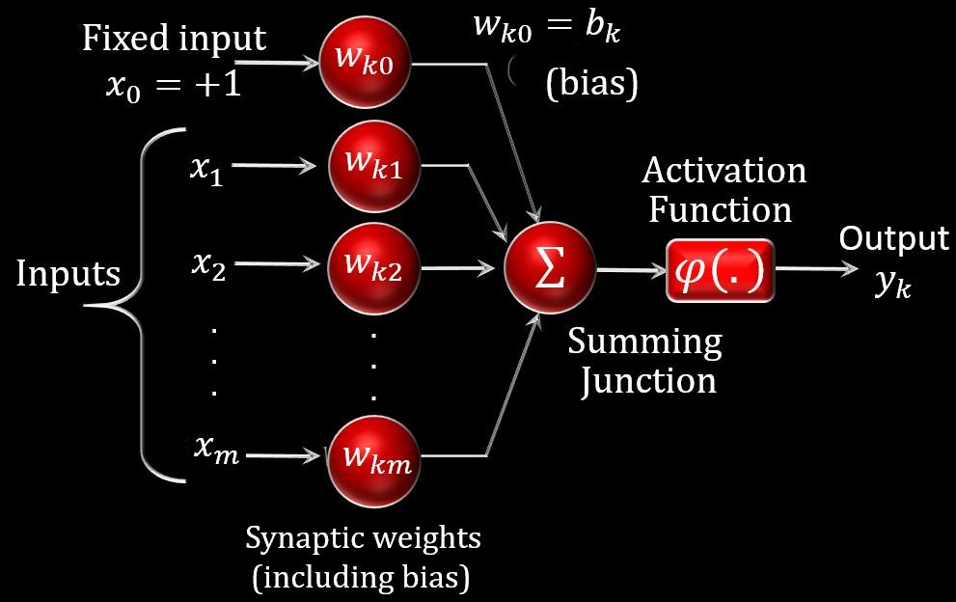
Artificial Neural Network Connections
This value is then passed to a non-linear activation function 𝑓 to produce the output 𝑓 (𝑏 + σ_{𝑖} 𝑤_{𝑖}𝑥_{𝑖} )
This is the activation of the neuron and is the value passed to other neurons connected to its axon
9

Slide 10
Artificial Neural Network Connections
Fixed input
𝑥₀ = +1
𝑤_{𝑘𝑜} = 𝑏_{𝑘}
𝑤
(𝑏𝑖𝑎𝑠)
𝑘𝑜
𝑥₁
^{𝑤}𝑘1
Activation Function
ϕ(.)
𝑥₂
.
.
.
𝑥_{𝑚}
Σ
^{𝑤}𝑘2
.
.
.
^{𝑤}𝑘𝑚
Inputs
Output
𝑦_{𝑘}
Summing Junction
Synaptic weights
(including bias)
20

Slide 11
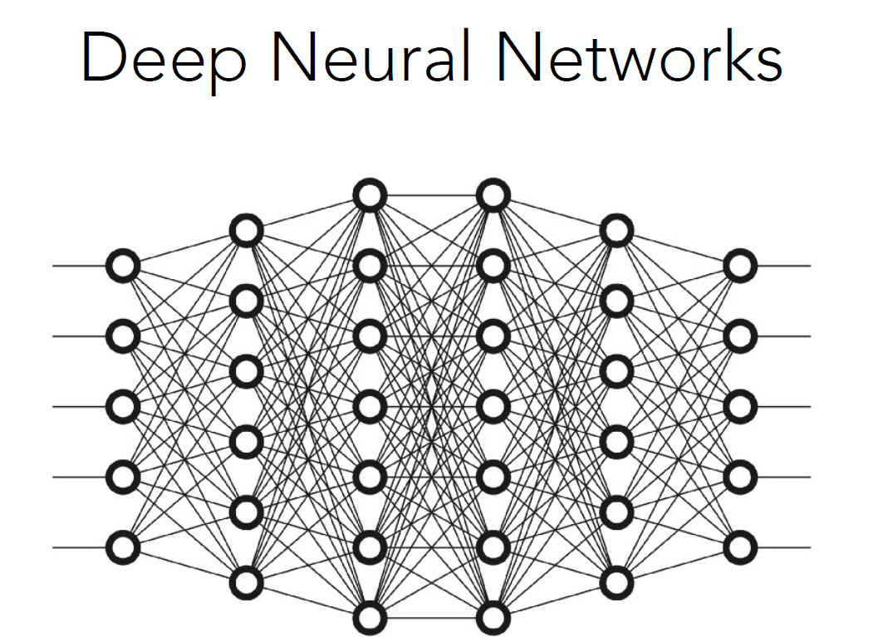

Slide 12
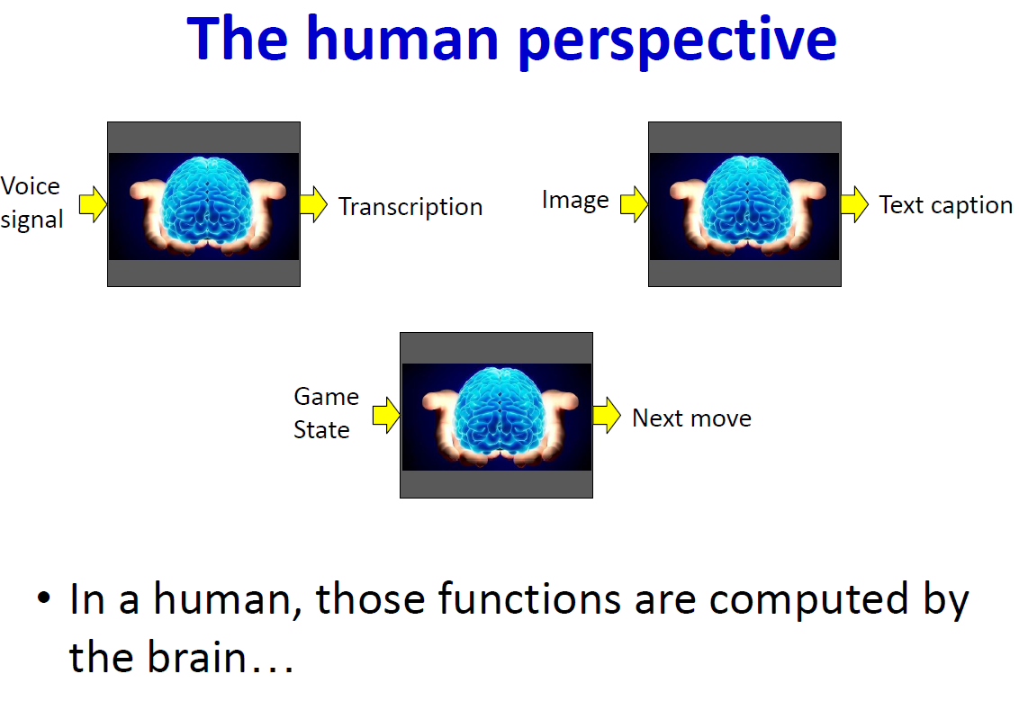

Slide 13
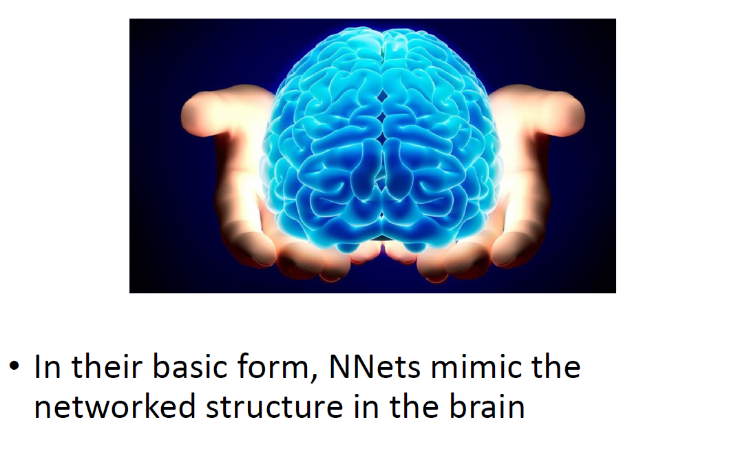
Deep Learning
13

Slide 14
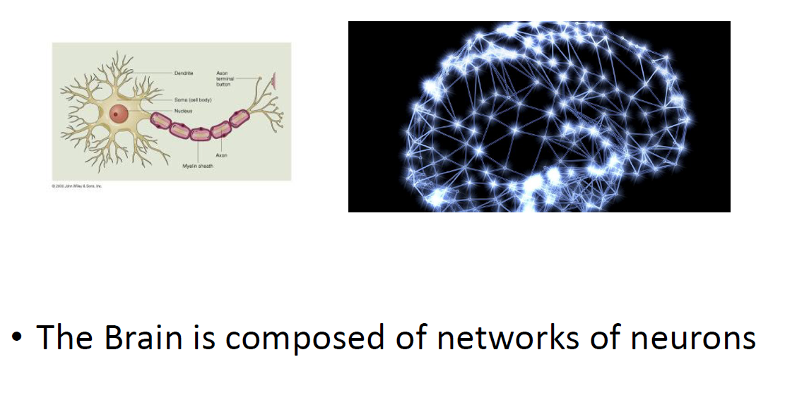
Deep Learning
14

Slide 15
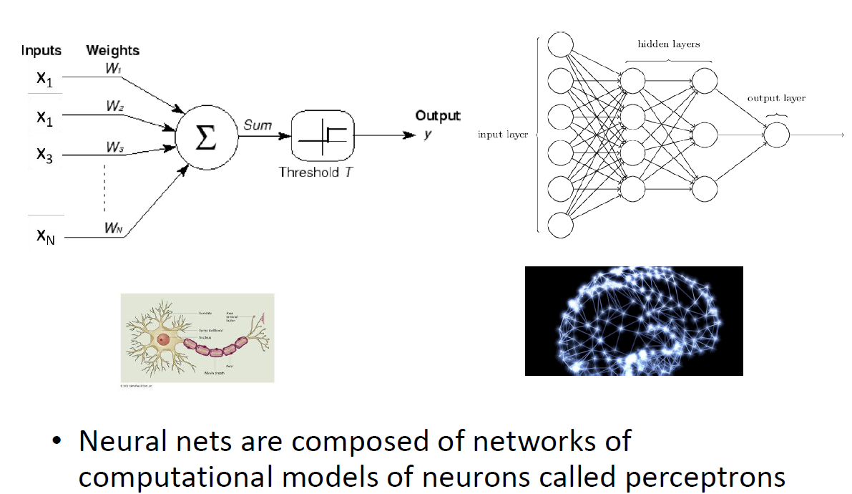
Deep Learning
15

Slide 16
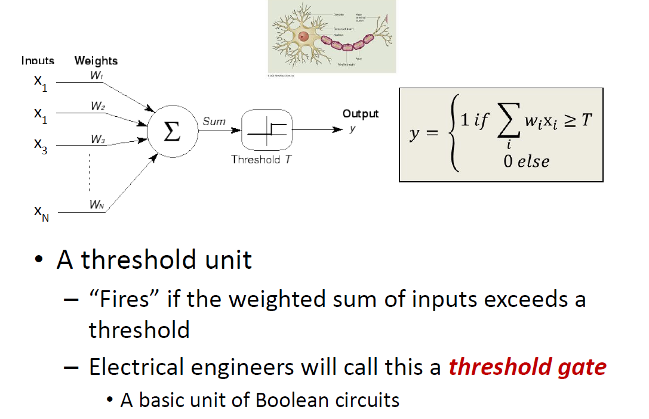
Deep Learning
16

Slide 17
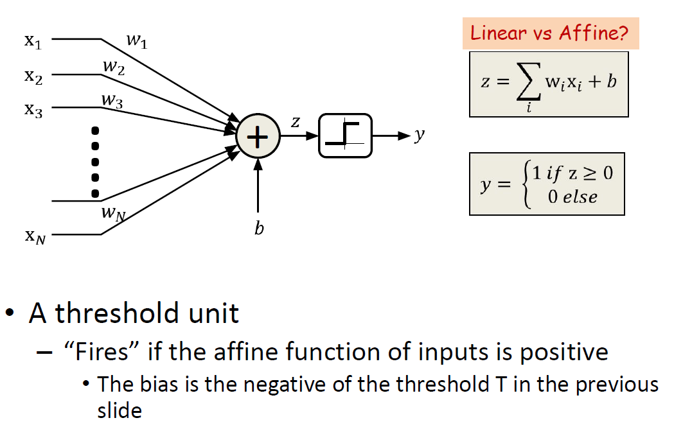
Deep Learning
17

Slide 18
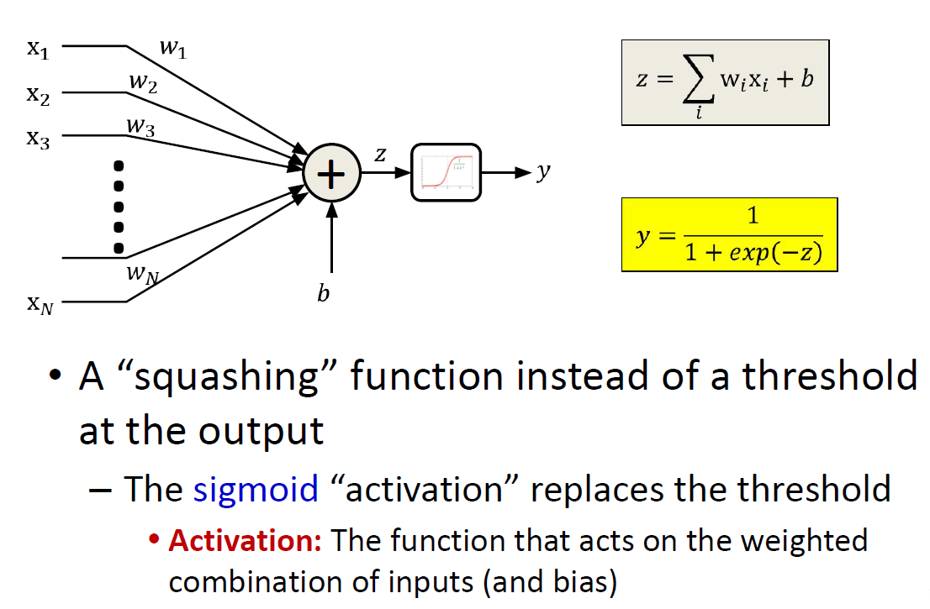
Deep Learning
18

Slide 19
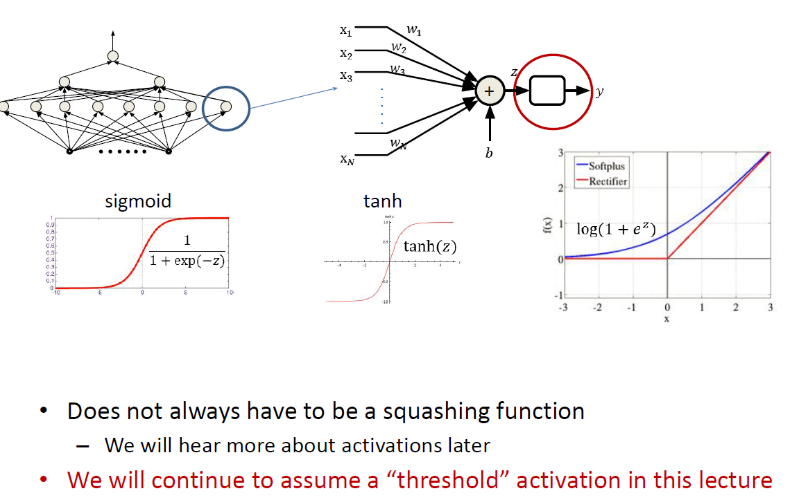
Deep Learning
19

Slide 20
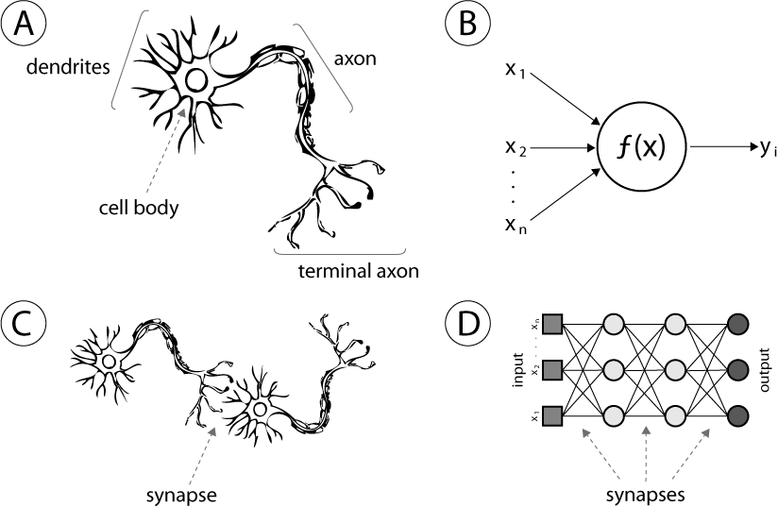
Deep Learning
20

Slide 21
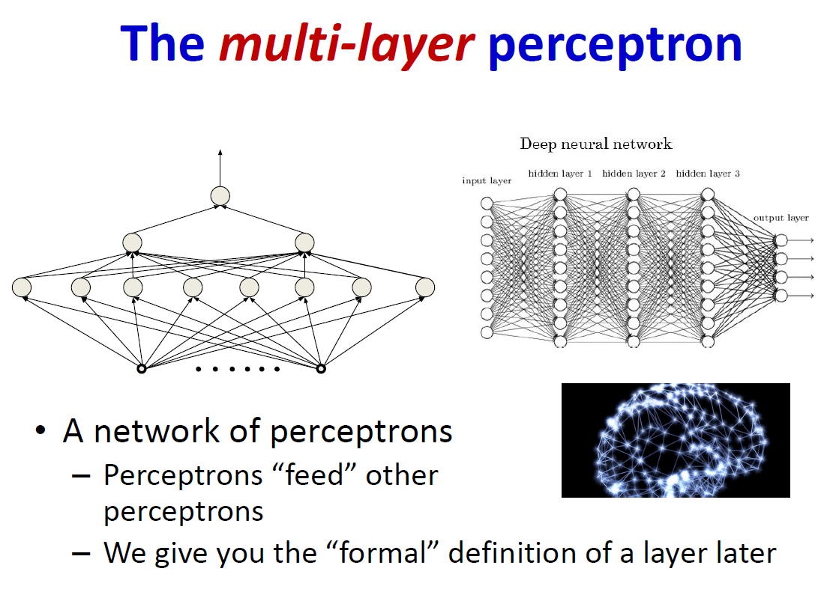
Deep Learning
21

Slide 22
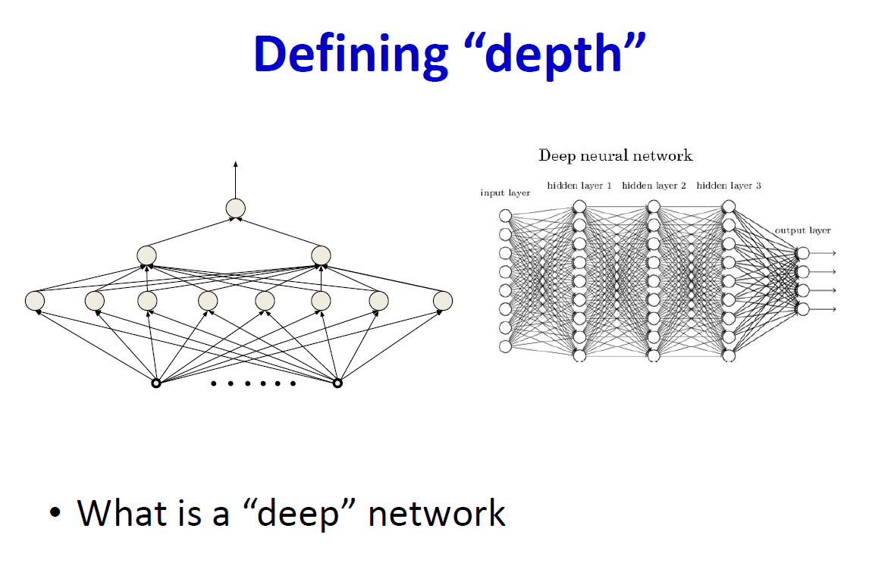
Deep Learning
22

Slide 23
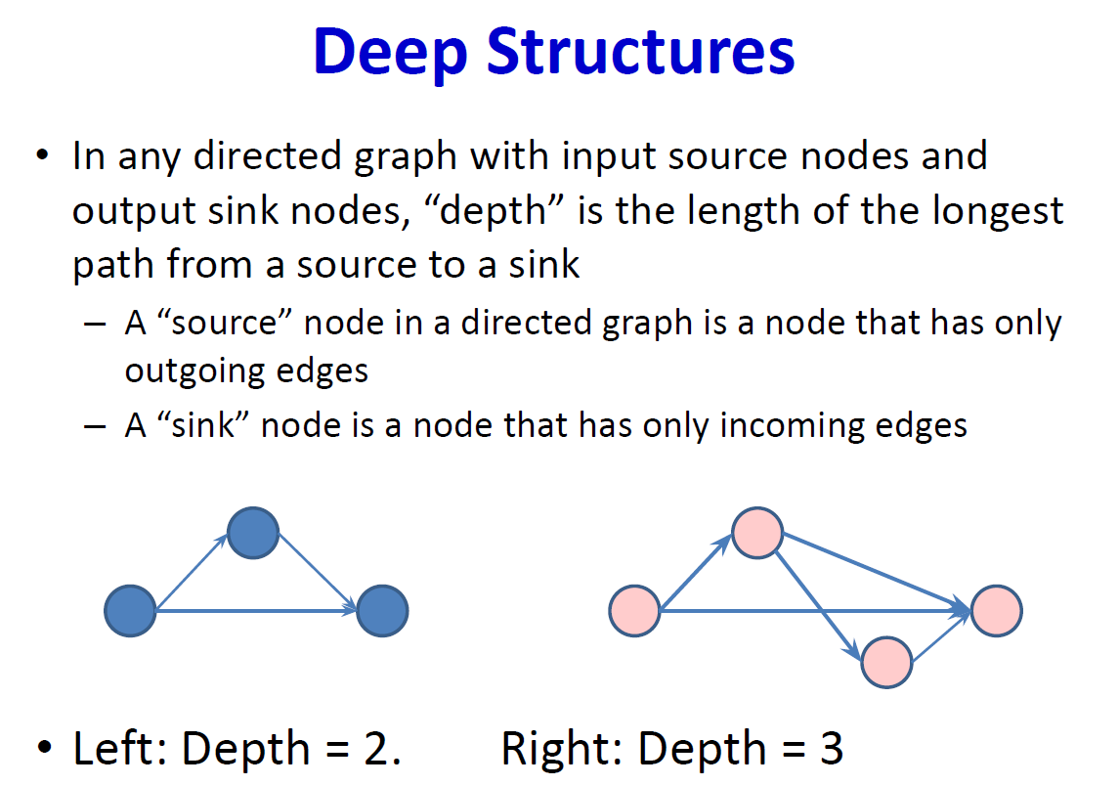
Deep Learning
23

Slide 24
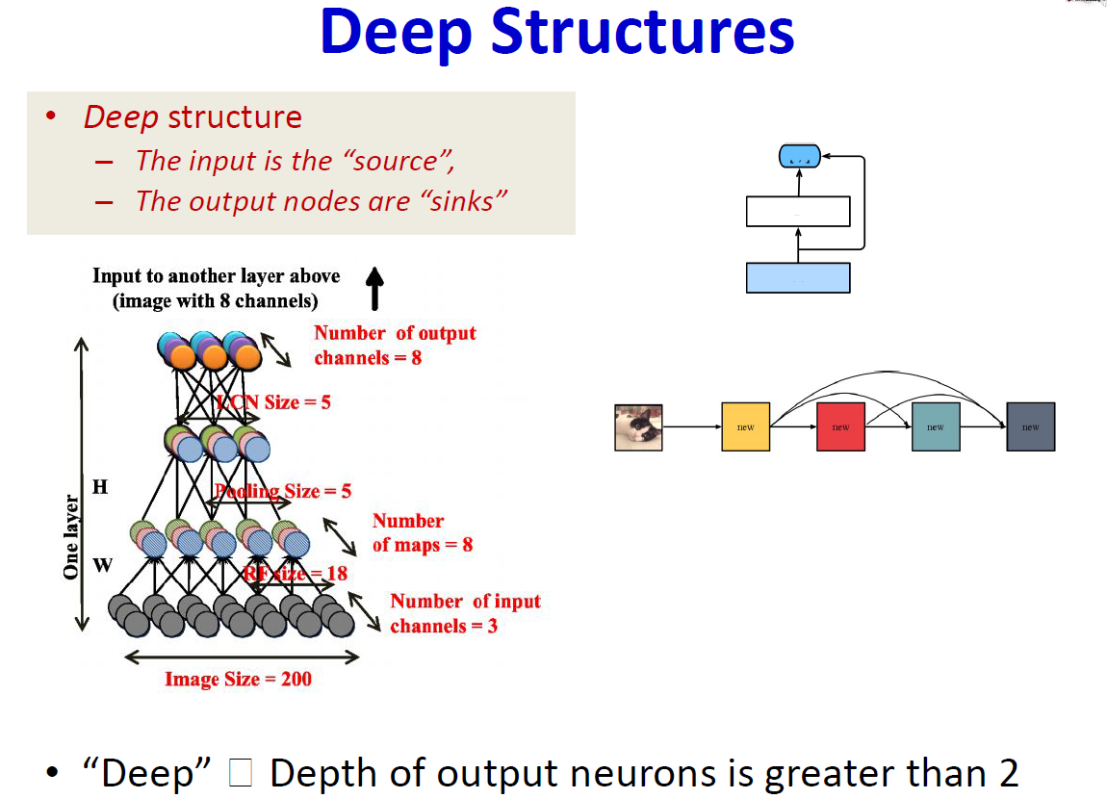
Deep Learning
24

Slide 25
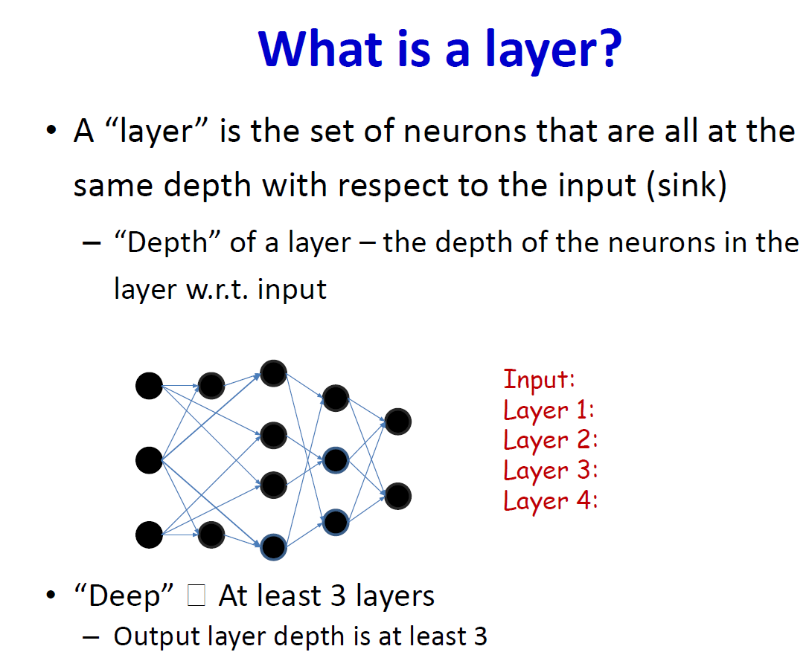
Deep Learning
25

Slide 26
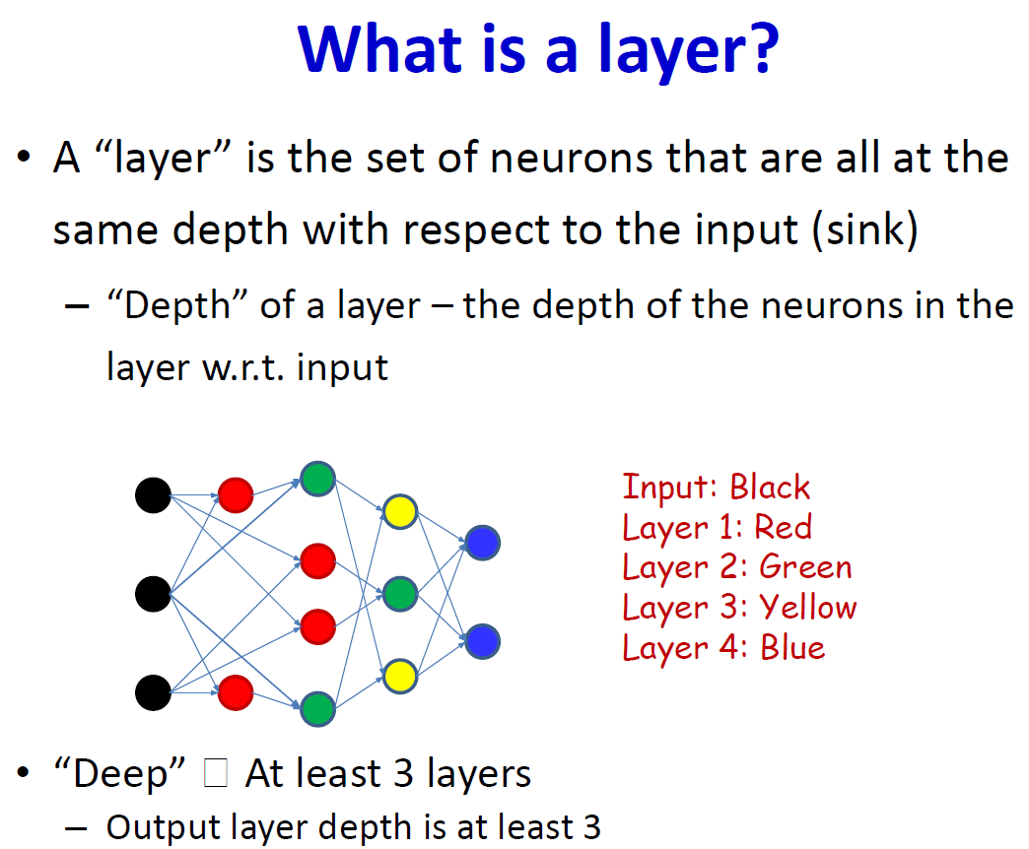
Deep Learning
26

Slide 27
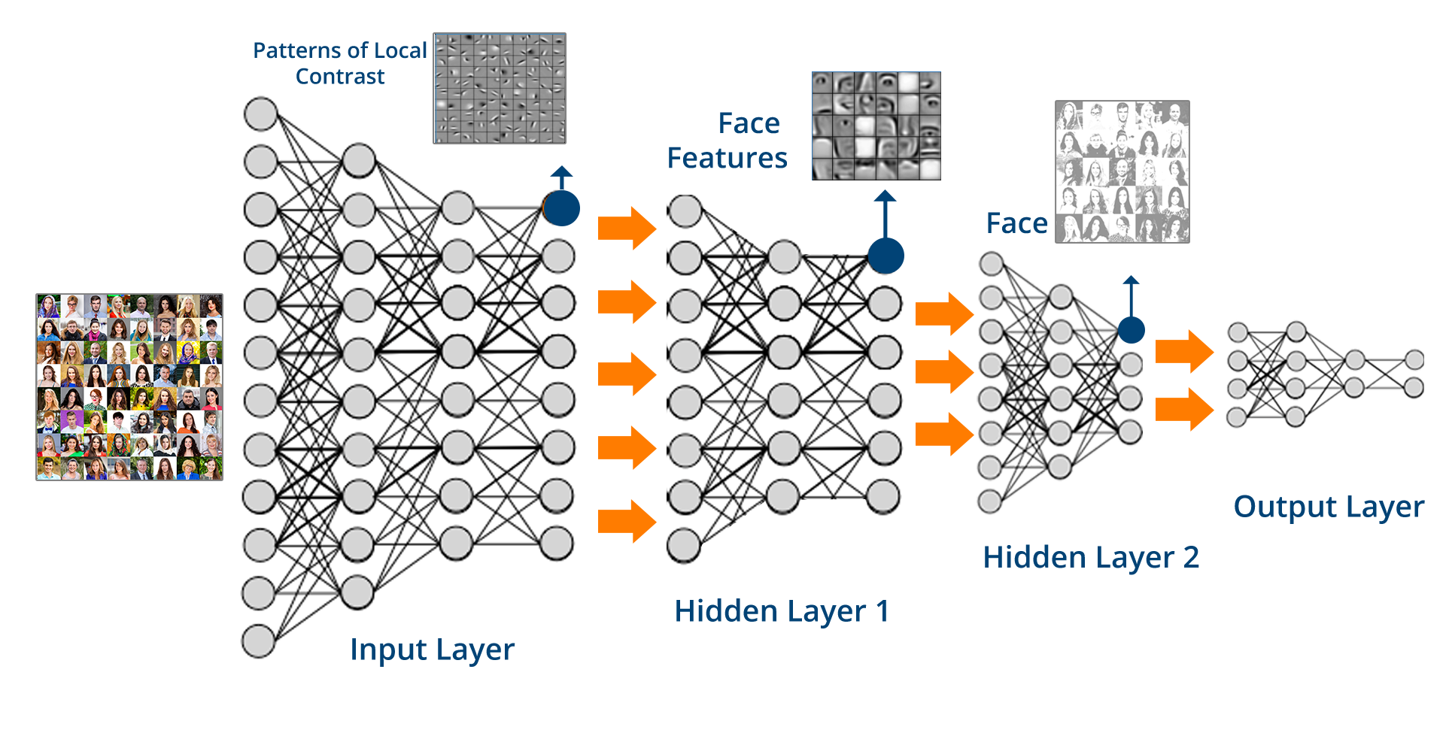
Deep Learning
27

Slide 28

Deep Learning
28

Slide 29
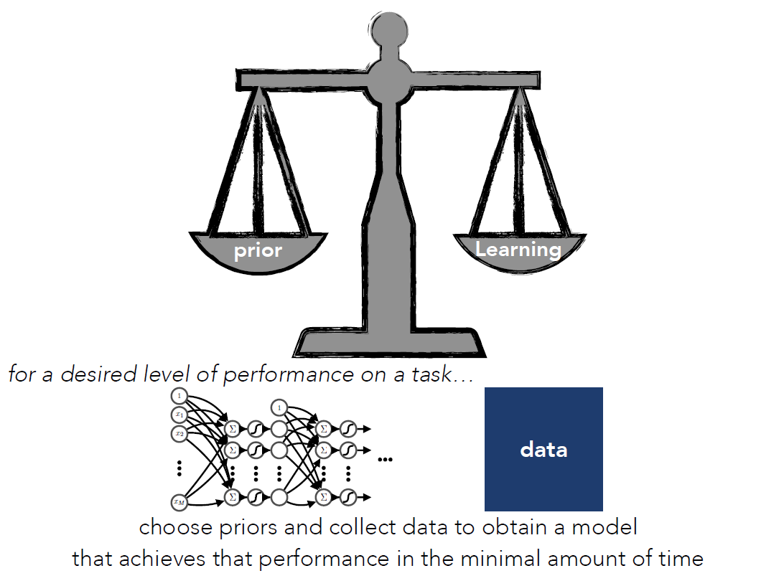
Deep Learning
29
Notes:
The image illustrates the concept of deep learning by showing a balance between two important components: "prior" and "learning." On the left side of the balance, "prior" represents prior knowledge and experience that serves as a starting point for the model's learning. On the right side, "learning" refers to the process of training the model with new data and extracting meaningful results from it. The balance between these two elements must be achieved for optimal performance. At the bottom, it is mentioned that to achieve the desired level of performance on a task, appropriate data must be chosen, and priors must be selected to obtain a model that performs efficiently in the minimal amount of time.

Slide 30
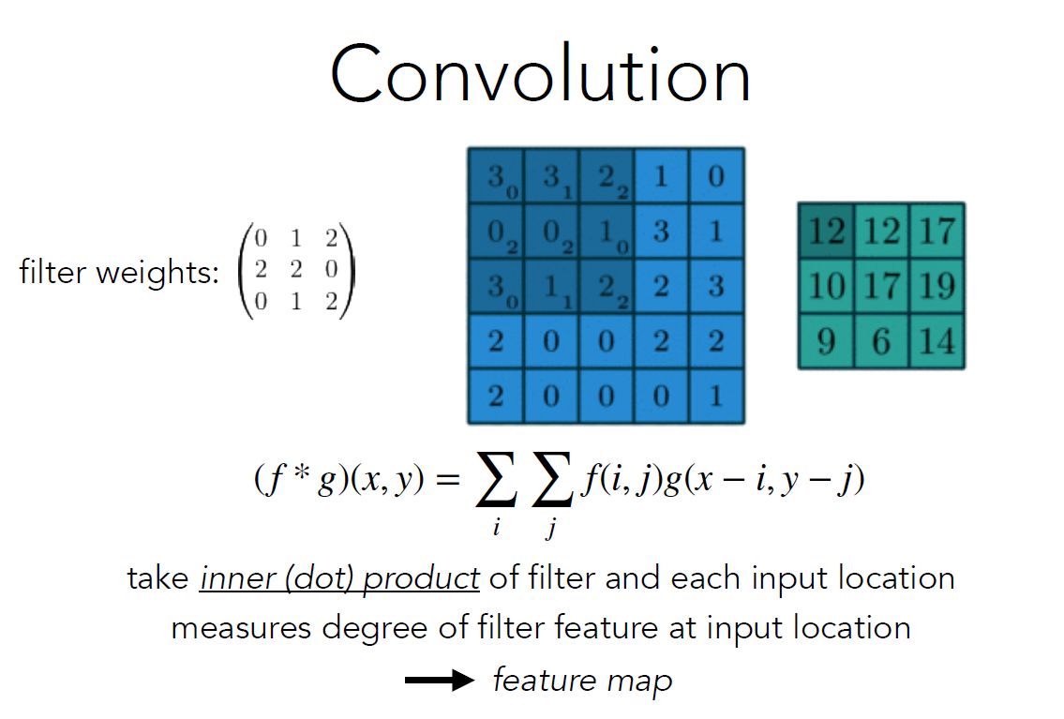
Deep Learning
30
Notes:
This image explains the convolution operation, which is commonly used in deep learning, especially in Convolutional Neural Networks (CNNs). The image shows the process where a filter (the matrix on the left) is applied over the input data (the large blue matrix). The filter slides over the input, and at each position, an inner (dot) product is computed between the filter and the corresponding input locations. The result of this operation measures how strongly the filter's feature matches the input at that location. This generates a "feature map" as the output. The process helps in learning patterns and features from the data.

Slide 31
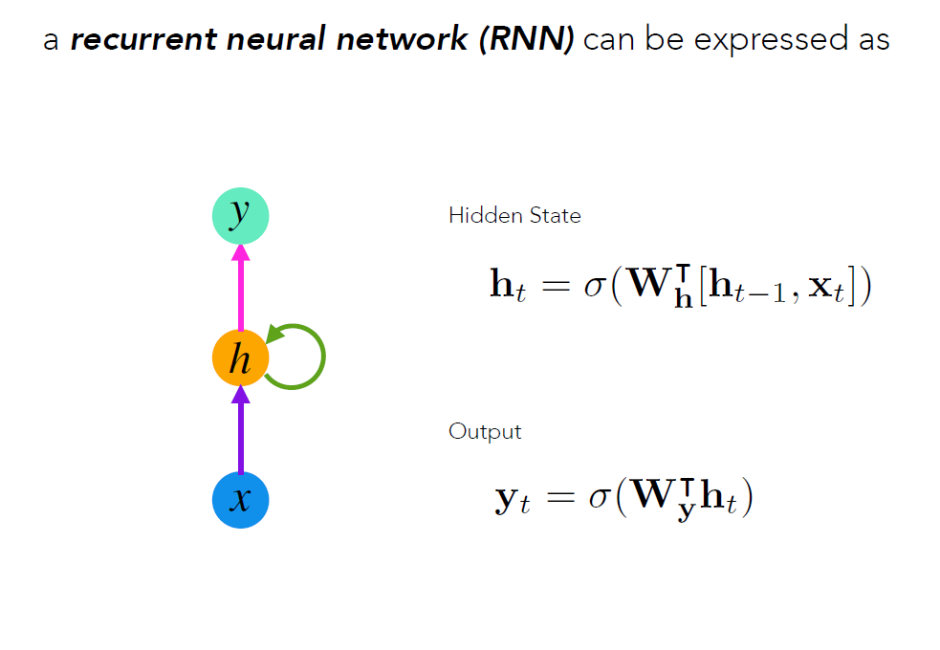
Deep Learning
31

Slide 32
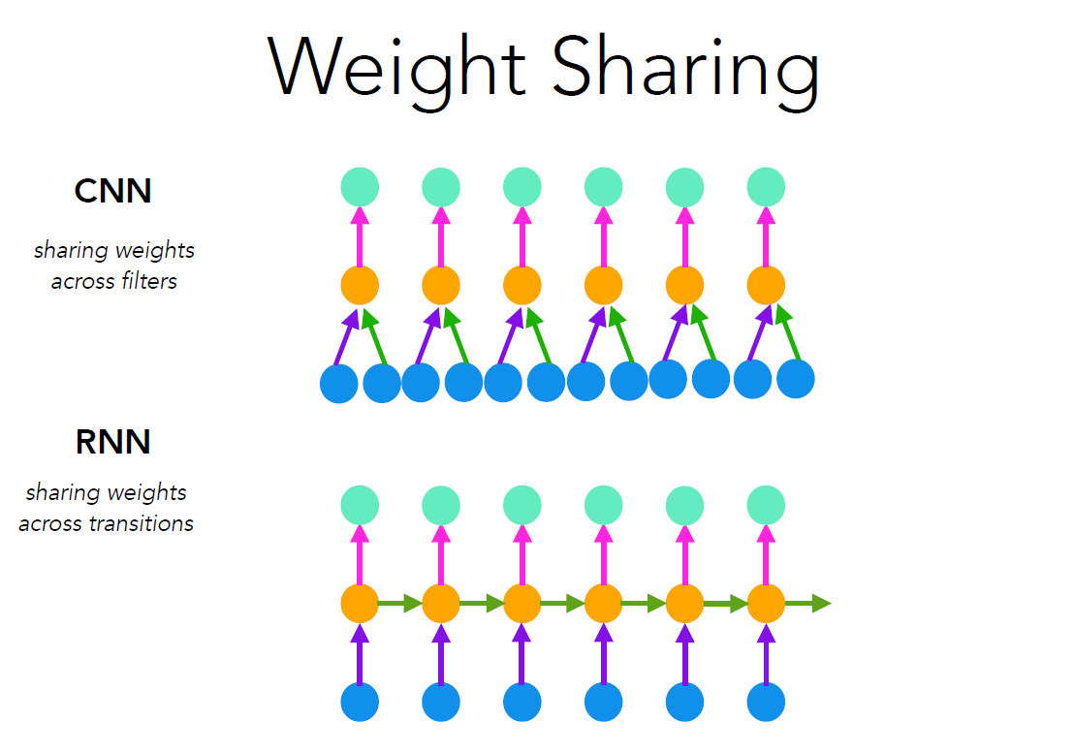
Deep Learning
32

